Slide 1
STOR 455 Class 3
Read: 1.1-1.6
Exercises: #1.3, 5, 7, 9, 15, 17, 21, 23, 25

Slide 2
Single Quantitative Predictor Model
Notation: Y = Response variable
X = Predictor variable
Assume (for now) that both Y and X are quantitative variables.

Slide 3
Simple Linear Model
X = Single quantitative predictor
Y = Quantitative response
Find a line that best summarizes the trend in the data.
Y
X

Slide 4
Simple Linear Model
response
random error
Y = β_{o} + β₁X + ε
intercept
predictor
slope
Assume: ε ~ N( 0, σ_{ε}) and independent
Three parameters to estimate: β_{o}, β₁, σ_{ε}

Slide 5
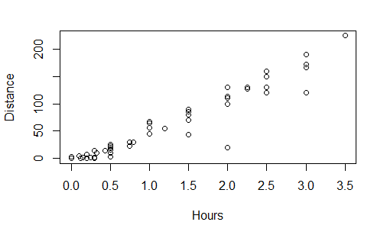
Scatterplot in R
plot(Distance~Hours,data=Domestic)

Slide 6

Least Square Regression in R
Syntax: lm(Response~Predictor,data= )
lm(Distance~Hours,data=Domestic)
Call:
lm(formula = Distance ~ Hours, data = Domestic)
Coefficients:
(Intercept) Hours
-11.06 59.98
$$\hat{Distance}=−11.06+59.98(Hours)$$

Slide 7
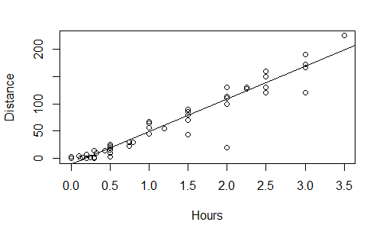
R – Plot with Fitted Line
mod1=lm(Distance~Hours,data=Domestic)
plot(Distance~Hours,data=Domestic)
abline(mod1)

Slide 8
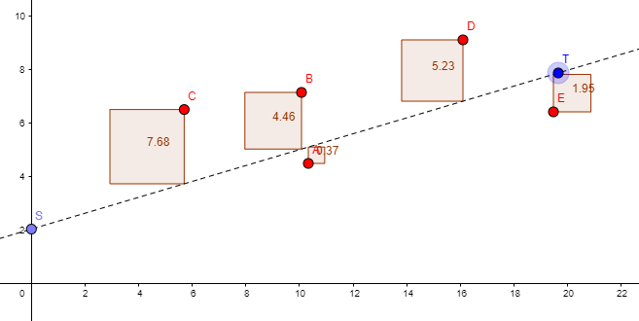
Simple Linear Model
X = Single quantitative predictor
Y = Quantitative response
Interactive Regression Model

Slide 9
Simple Linear Model- Conditions
Model:
Linearity: The means for Y vary as a linear function of X.
Error:
Zero Mean: The distribution of the errors is centered at zero.
Constant variance: The variance for Y is the same at each X. (Homoscedasticity)
Independence: No relationships among errors.
Normality:
Residuals are normally distributed
(sometimes) At each X, the Y’s follow a normal distribution.

Slide 10
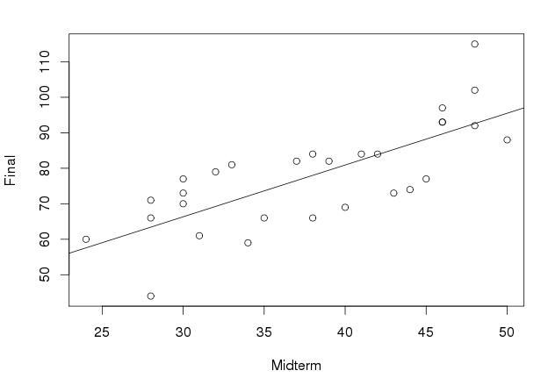
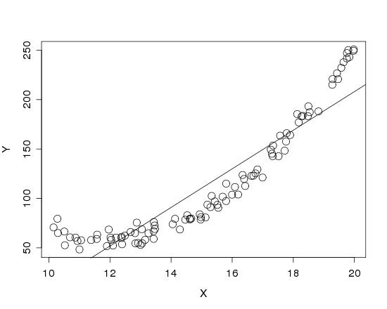


Is it Linear?
Look for consistent curvature or non-linear patterns

Slide 11
R – Plot with Fitted Line
mod1=lm(Distance~Hours,data=Domestic)
plot(Distance~Hours,data=Domestic)
abline(mod1)

Slide 12
Simple Linear Model- Conditions
Model:
Linearity: The means for Y vary as a linear function of X.
Error:
Zero Mean: The distribution of the errors is centered at zero.
Constant variance: The variance for Y is the same at each X. (Homoscedasticity)
Independence: No relationships among errors.
Normality:
Residuals are normally distributed
(sometimes) At each X, the Y’s follow a normal distribution.
✅

Slide 13
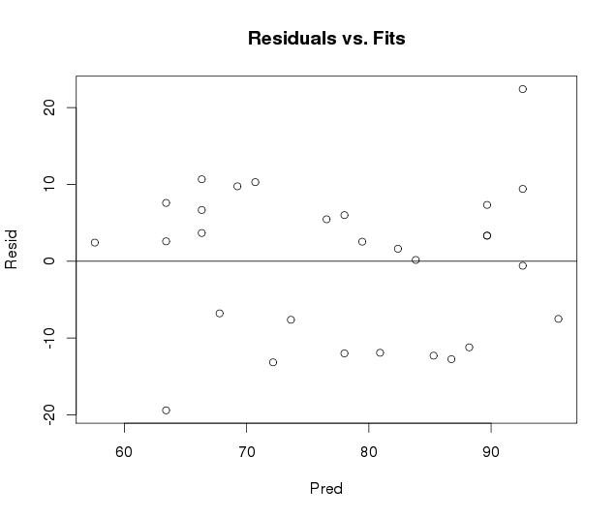
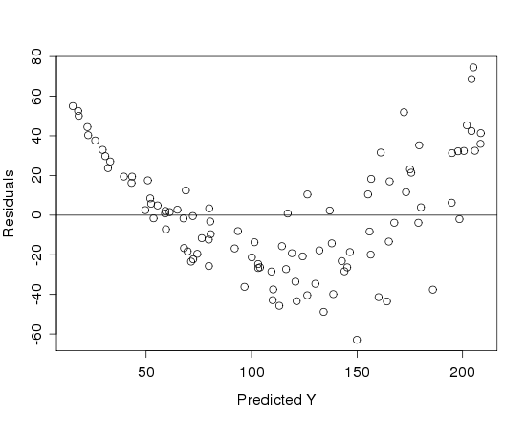

Is it Linear?
Plot the residuals vs. the predictions

Slide 14
More Regression in R
Save the results of the linear model in a variable:
mod1=lm(Distance~Hours,data=Domestic)
… then access information from the model
summary(mod1) #gives more information
mod1$residuals #contains residuals
mod1$fitted.values #contains fitted values

Slide 15
Model Summary in R
mod1=lm(Distance~Hours,data=Domestic)
summary(mod1)
Call:
lm(formula = Distance ~ Hours, data = Domestic)
Residuals:
Min 1Q Median 3Q Max
-88.892 -4.680 2.172 7.082 26.141
Coefficients:
Estimate Std. Error t value Pr(>|t|)
(Intercept) -11.063 4.056 -2.727 0.00868 **
Hours 59.977 2.484 24.144 < 2e-16 ***
---
Signif. codes:
0 ‘***’ 0.001 ‘**’ 0.01 ‘*’ 0.05 ‘.’ 0.1 ‘ ’ 1
Residual standard error: 18.26 on 52 degrees of freedom
Multiple R-squared: 0.9181, Adjusted R-squared: 0.9165
F-statistic: 582.9 on 1 and 52 DF, p-value: < 2.2e-16

Slide 16
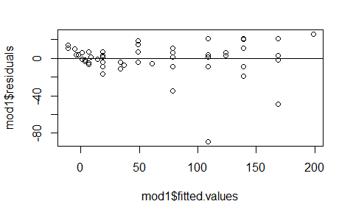
R – Plot with Fitted Line
plot(mod1$residuals~mod1$fitted.values)
abline(a=0, b=0)

Slide 17
Simple Linear Model- Conditions
Model:
Linearity: The means for Y vary as a linear function of X.
Error:
Zero Mean: The distribution of the errors is centered at zero.
Constant variance: The variance for Y is the same at each X. (Homoscedasticity)
Independence: No relationships among errors.
Normality:
Residuals are normally distributed
(sometimes) At each X, the Y’s follow a normal distribution.
✅

Slide 18
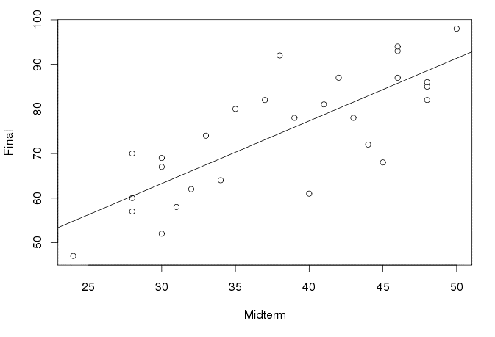
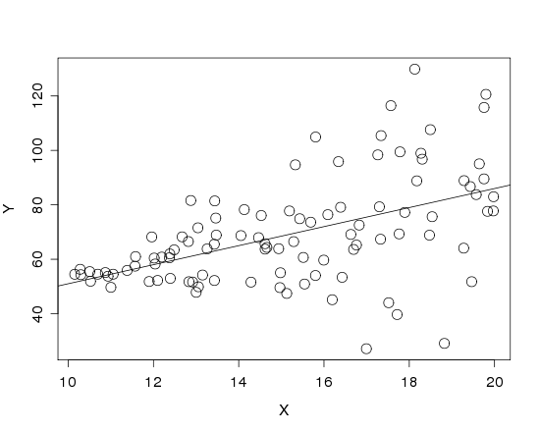
Is the Variance Constant?
Look at a scatterplot with the regression line drawn on it.
Look for “fan-shaped” pattern

Slide 19
R – Plot with Fitted Line
mod1=lm(Distance~Hours,data=Domestic)
plot(Distance~Hours,data=Domestic)
abline(mod1)

Slide 20
Simple Linear Model- Conditions
Model:
Linearity: The means for Y vary as a linear function of X.
Error:
Constant variance: The variance for Y is the same at each X. (Homoscedasticity)
Independence: No relationships among errors.
Normality:
Residuals are normally distributed
(sometimes) At each X, the Y’s follow a normal distribution.
✅
✅

Slide 21
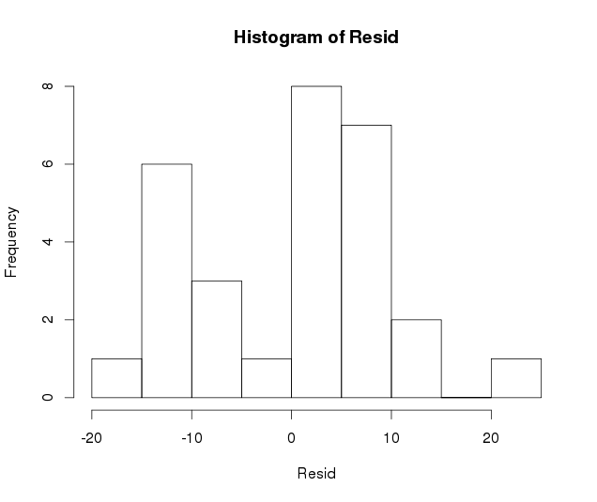
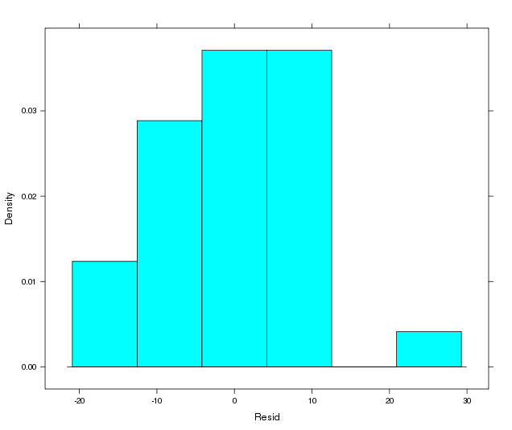
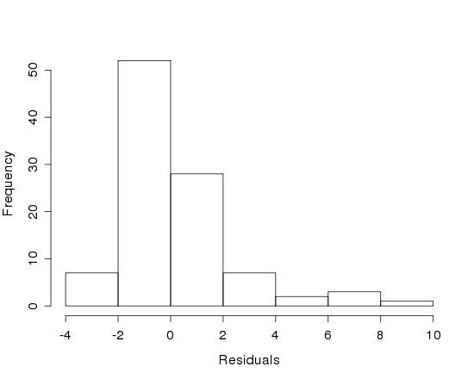
Are the Residuals Normal?
Look at a histogram of the residuals
?
Look for clear skewness and outliers

Slide 22
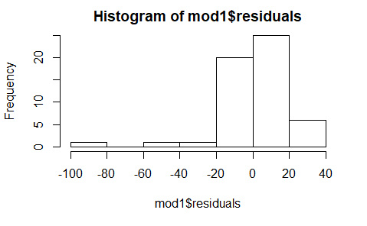
Are the Residuals Normal?
hist(mod1$residuals)

Slide 23
Are the Residuals Normal?
Look at a normal quantile plot
Scatterplot of residuals vs. a “perfect” normal sample.
Straight line ↔ Normal data

Slide 24
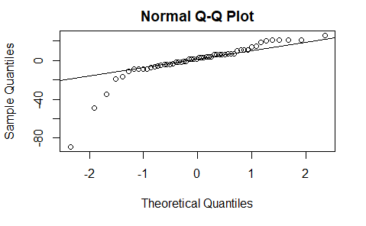
Are the Residuals Normal?
qqnorm(mod1$residuals)
qqline(mod1$residuals)

Slide 25
Simple Linear Model- Conditions
Model:
Linearity: The means for Y vary as a linear function of X.
Error:
Constant variance: The variance for Y is the same at each X. (Homoscedasticity)
Normality:
Residuals are normally distributed
(sometimes) At each X, the Y’s follow a normal distribution.
✅
✅
_?_

Slide 26
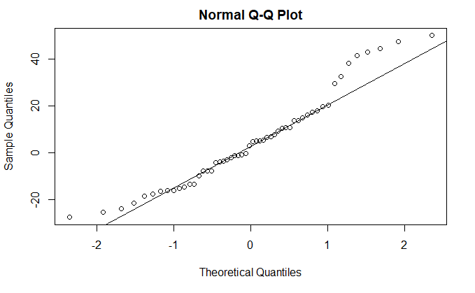
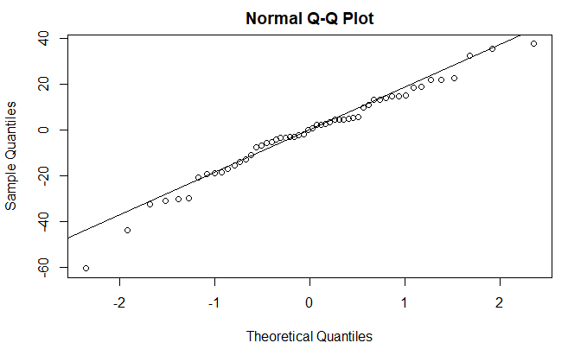
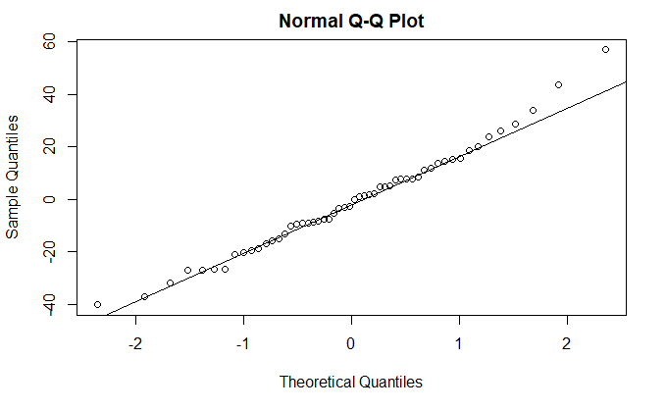
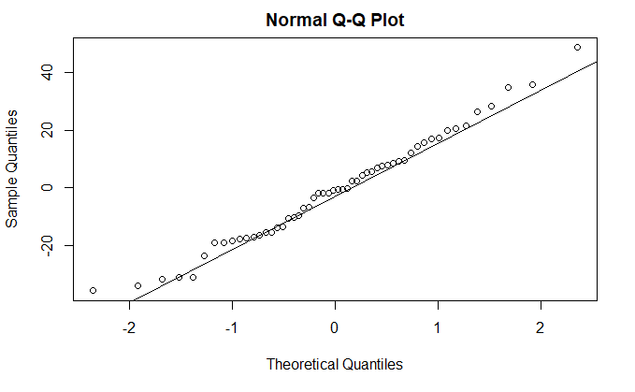
How much Variability is Expected?
x <- rnorm(54, 0, 18.26)
qqnorm(x)
qqline(x)

